Slide 1
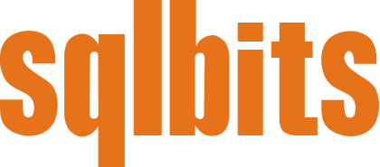
SQL Server ML from End-to-End
Anna Thomas, Data & Applied Scientist
SQL Server, Microsoft
antho@microsoft.com
Notes:
Hi everyone, my name is Anna Thomas. I’m a data and applied scientist slash PM on the engineering team for SQL Server
So, just a little background on me, about 3 months ago, I moved over from AI Engineering, where I was developing models, but more often than not I was in the space of Conversational AI. So, bots, natural language processing, and really just enhancing applications with AI or ML.
So anyway, I came over from AI Engineering, I’m now in the SQL Server engineering team. So I am very new to SQL. And I don’t want to front like I’m not, because I know all of you in the room are probably experts. Can I actually do a poll? How many of you have been working with SQL for 5 years? 10? 15? 20? More than that??
OK so I will not pretend to be the SQL expert here. What I will promise you though, is if I do not know the answer to your question, I should be able to find it – right, someone in SQL Server engineering should hopefully have the answer, so if you email me, I will get you to the answer.
Talk about my background and how it’s a bit weird
New to SQL Server
Perhaps start with a poll for how long people have been working with SQL

Slide 2
Introduction
Notes:
Does that sound ok with everyone? OK let’s get started.

Slide 3
Overview
Learn how Machine Learning Services in SQL Server is a powerful end-to-end ML platform for customers, on both Windows and Linux. Come learn about the unique value proposition of doing your entire machine learning pipeline in-database – right from data pre-processing, feature engineering, and model training to deploying ML models and scripts to production in secure and compliant environment without moving data out.
Notes:
I want to talk about the lifecycle of Machine Learning projects, and how SQL Server ML Services fits into that.
First, let’s do a quick poll. This is marked as a 200 level session. I don’t really know what that means, but based on your responses, I can try to make it valuable for you.
Raise your hand if you…
Are aware of ML
Know what ML can be used for
Have created ML models in R or Python
Have deployed ML models in production environments
Have used SQL ML services for Python or R workloads before

Slide 4
Agenda
Intro to the TDSP
Business Understanding
Data Acquisition and Understanding
Modeling
Deployment
Customer Acceptance
Where to learn more
Notes:
Lots to cover in 50 minutes, and I want to leave time for me to attempt to answer questions, so let’s get started
Intro + Intro to TDSP: 10 minutes
Business understanding: 10 minutes
Data acquisition + demo: 7 minutes
Modeling: 7 minutes
Deployment: 7 minutes
Customer acceptance: 3 min
Closing + QnA: 6 min

Slide 5
Intro to the TDSP
Notes:
Anyone heard of the TDSP? Anyone want to explain? Awesome. So I actually want to back up for a second first and talk about “Data Science”

Slide 6
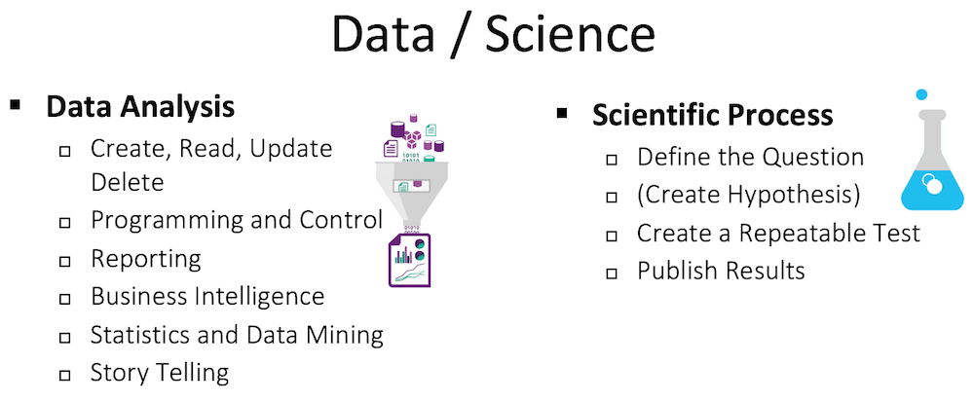
Notes:
Data Science is an "umbrella" term that encompasses almost all Advanced Analytics. It combines the processes from working with data with technology, and also the scientific process.

Slide 7
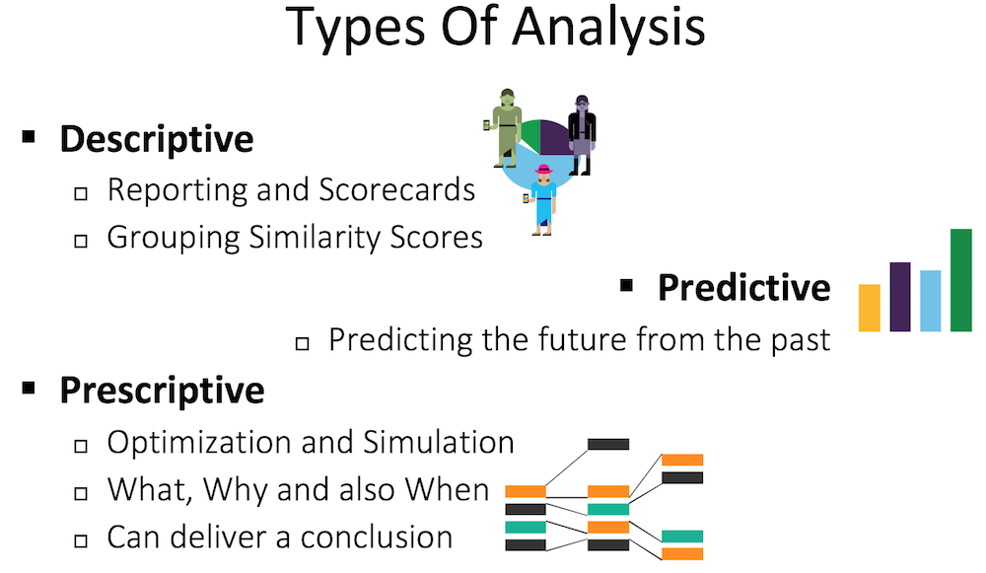
Notes:
Typically, we lump the three types of analysis as Descriptive, predictive, and prescriptive
To do predictive and prescriptive analysis, Data Science teams leverage Machine Learning. Machine Learning consumes large amounts of data in the form of Features (really just columns) and Labels (which is the column you’re trying to predict). For instance, the current weather, and time of day may be able to help in predicting if I will walk back to my hotel or uber tonight

Slide 8
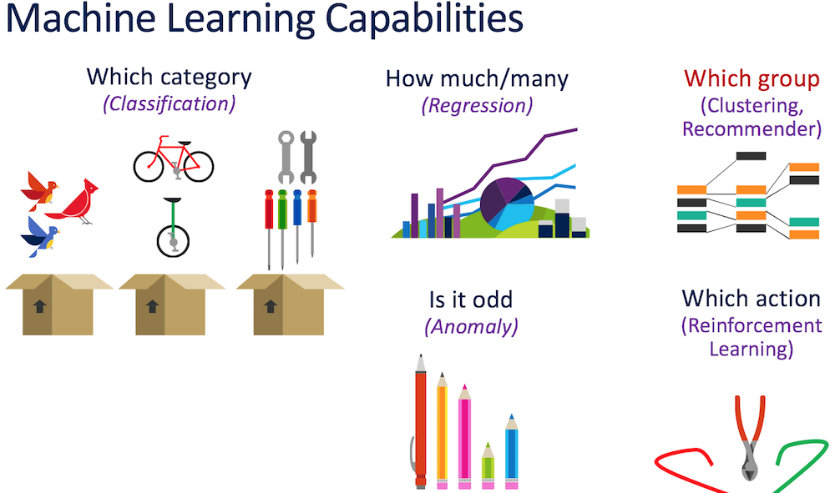
Notes:
There are various "families" of algorithms that you can use to answer five basic types of questions.
Machine Learning uses algorithms to create (what they call train) a Model. The training looks at various Features (remember those are columns) and "learns" how it affects a supplied "Label". It then selects the best path to work with data it has not seen. You can then send new data (Features) and the Model will return it's guess for the Label, usually along with how confident it is in the guess.
Cup example for simple classification

Slide 9
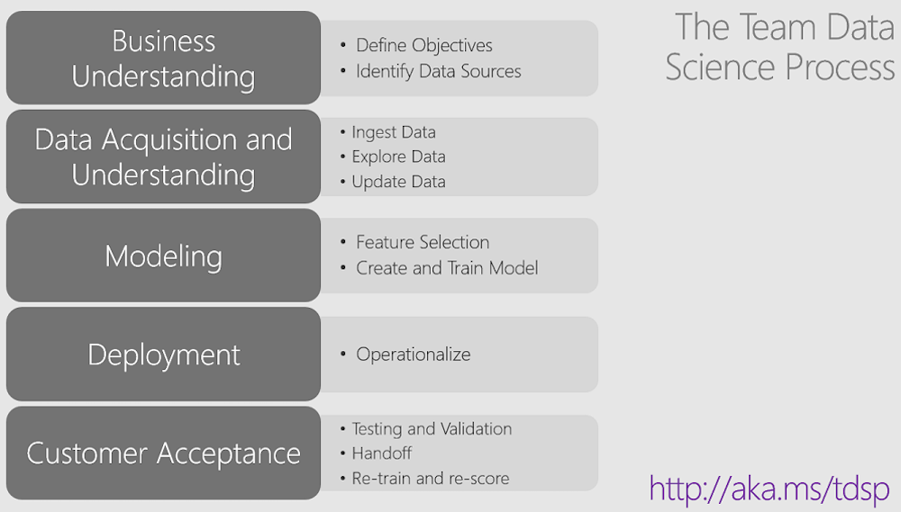
The Team Data Science Process
Notes:
This is the TDSP, and Microsoft actually considers this a product. At the link, you can find guidance on how to work through ANY machine learning project. It guides you through, they have sample documents and presentations and project plans, it’s all there for you.
Another thing I want to call out is that this is a Team process. You need the Data Engineers, Data Scientists, Project owners, and LT / sponsorship involved in order to be successful.

Slide 10
SQL ML Services: Better collaboration and E2E efficiency
Data scientist
T-SQL
Explore
Train
Explore and experiment with data
Stay in your favorite IDE - use R, Python or T-SQL
Train models remotely on SQL Server
Use R/Python code embedded in T-SQL stored proc
App developer
Data scientist
SQL Server
Machine Learning Services
Share & consume
Deploy
Consume ML models from any app
Make simple stored proc calls
SQL developer/DBA
Deploy training/scoring scripts in-DB
Make models accessible to any app
Manage model version in DB
Notes:
In this session, we’ll walk through each of the TDSP steps, focusing on how it applies to SQL ML Services. From a high level, you can see it’s quite similar. After we understand the objectives, we explore and understand the data, then we train our model, then we deploy it, and finally we share and consume it. And as we get more data we repeat the process.

Slide 11
ML Services on SQL Server on Linux
Starting with CTP 2.0 of SQL Server 2019
Supported on all flavors of Linux where SQL Server is supported
sudo apt-get install mssql-mlservices-packages-py
sudo apt-get install mssql-mlservices-packages-r
sudo zypper install mssql-mlservices-packages-py-9.4.5*
sudo zypper install mssql-mlservices-packages-r-9.4.5*
sudo yum install mssql-mlservices-packages-py-9.4.5*
sudo yum install mssql-mlservices-packages-r-9.4.5*
Notes:
While we’re talking about SQL ML overall, I wanted to touch on a few other things briefly.
ML services is supported in the same way on Linux. Today, my SQL Server instance is actually running on Linux

Slide 12
Security and Governance
Reduced surface area and isolation
R/Python script execution outside of SQL Server process space
‘external scripts enabled’ required
Script execution requires explicit permission
sp_execute_external_script requires EXECUTE ANY EXTERNAL SCRIPT for non-admins
SQL Server login/user required and db/table access
R/Python processes have limited privileges
R/Python processes run isolated under different AppContainer* SIDs
Different users with different AppContainers
Windows firewall rules to block outbound traffic
Built-in Resource Governance
Securely enable your org to do ML – govern external resources (memory, CPU)
Notes:
We’ll talk about this more later, but ML Services runs outside of the engine. It uses a process called ‘launchpad’ to do in-database analytics in satellite programs

Slide 13
Support for partitioned data
Easily generate multiple models from partitioned data
Using T-SQL: New parameters in sp_execute_external_script
Using R/Python: Using rxExecBy, rx_exec_by
input_data_1_partition_by_columns: specifies a column to partition by
input_data_1_order_by_columns: specifies which columns to order by
Notes:
Ability to create and train models over partitioned data

Slide 14
Business Understanding
Notes:
So now that you’ve gotten a ‘primer’ for the TDSP and SQL ML Services, let’s put them together

Slide 15
Business Understanding – Goals
Define Objectives
Identify data sources
Notes:
The first phase in the TDSP is Business understanding. Here, we want to
understand and identify the business problems. We want to formulate questions that define the business goals that the data science techniques can target.
We also want to find the relevant data that helps you answer the questions that define the objectives of the project.
Specify the key variables that are to serve as the model targets and whose related metrics are used determine the success of the project.
Define objectives: Work with your customer and other stakeholders to understand and identify the business problems. Formulate questions that define the business goals that the data science techniques can target.
Identify the relevant data sources that the business has access to or needs to obtain.
Identify data sources: Find the relevant data that helps you answer the questions that define the objectives of the project.

Slide 16

Example – Contoso Wines
Contoso Wines is a popular wine store that is famous for having an ever-changing selection of high quality wines. They’ve been in business for over twenty years. As their shop grows, they are having to sort through more wines and hire more wine experts and scientists to determine the high quality wines.
Since opening, the shop has kept track of all the testing and quality measurements for each wine in a SQL Server database. They have privacy restrictions from their suppliers that restrict them from moving this data.
They’re looking to you to help them scale this operation, while maintaining their commitment to stocking high quality wines in the shop.
Notes:
So this is the example use case I want to work through in the session. As I read it, think about key words you think will influence our project. *Read example*. *Ask audience*

Slide 17
Example – Contoso Wines
Contoso Wines is a popular wine store that is famous for having an ever-changing selection of high quality wines. They’ve been in business for over twenty years. As their shop grows, they are having to sort through more wines and hire more wine experts and scientists to determine the high quality wines.
Since opening, the shop has kept track of all the testing and quality measurements for each wine in a SQL Server database. They have privacy restrictions from their suppliers that restrict them from moving this data.
They’re looking to you to help them scale this operation, while maintaining their commitment to stocking high quality wines in the shop.
Notes:
So these are some things that stand out to me. Any ideas on the questions we want to answer?

Slide 18
Example – Contoso Wines
Objective:
Create a program that can predict the quality of wine without a sommelier or scientist, without moving the data
Data source:
Wine data that has been collected manually by scientists and sommeliers by the company over the past 20 years, stored in SQL Server
Notes:
The question we want to answer is “What is the quality of this wine”

Slide 19
Data Acquisition and Understanding
Notes:
Once we have an idea of the business problem and what we want to do, it’s time to explore the data and determine if it could potentially answer the question

Slide 20
Data Acquisition & Understanding – Goals
Ingest
Explore
Update
Notes:
Ingest the data into the target analytic environment.
Explore the data to determine if the data quality is adequate to answer the question.
Set up a data pipeline to score new or regularly refreshed data.
ETL vs ELT
Goals for Data Acquisition and Understanding
Produce a clean, high-quality data set whose relationship to the target variables is understood. Locate the data set in the appropriate analytics environment so you are ready to model.
Develop a solution architecture of the data pipeline that refreshes and scores the data regularly.
How to do it
Ingest the data into the target analytic environment.
Explore the data to determine if the data quality is adequate to answer the question.
Set up a data pipeline to score new or regularly refreshed data.

Slide 21

SQL Server ML Services makes it easy
No data movement
No sampling
Work remotely from your dev environment
Remotely leverage the power of SQL Server
Work with any open source package in-database
Combine the best of open source and MS options
Streamlined model deployment without developer dependence
Model version management in-database
revoscale package
Execution
Data scientist workstation
Any R or Python IDE
Results
SQL Server
Notes:
SQL Server ML Services makes data exploration easy. We don’t have to select a sample, we can explore the whole dataset, because we don’t have to move it. Developers and data engineers or data scientists can work from their own and preferred environment, in the languages and tools they like, in R or Python
Current Data scientist workflow and problems
Data movement, restricted to samples, dependency on others, different tooling environment, deployment to production, updating the current models with fresh data
How does this environment solve this [demo]
Working in their favorite IDE - Jupyter
Data exploration step
Remote compute context training
Visualization
Model creation, evaluation, selection etc.
Ready for operationalization
Reinforce that none of it required any data movement
Use SQLML Utils to create sprocs
Switch to Data Studio/SSMS, show the sproc just created
Show the plumbing and how the mapping happens
Show the tables - training data, models, scored results etc.
Show the scoring sproc
Show the scored data
Show the PowerBI dashboard connecting to the scored data
Drive the point about existing reports/apps getting smarter by leveraging ML models

Slide 22
Revoscale for R and Python
Proprietary functions for data science at scale
At scale referring to the core engine’s ability to perform these tasks against very large datasets, in parallel and on distributed file systems
Chunks and reconstitutes data when it cannot fit in memory
revoscale package
Execution
Data scientist workstation
Any R or Python IDE
Results
SQL Server
Notes:
Anyone used the revoscale packages before?
These are proprietary functions for doing analysis at scale.
I say at scale because the core engine can perform these tasks in parallel and on distributed file systems
It’s not just for SQL, but you have to use it for in database analytics, and I’ll show you how.
Current Data scientist workflow and problems
Data movement, restricted to samples, dependency on others, different tooling environment, deployment to production, updating the current models with fresh data
How does this environment solve this [demo]
Working in their favorite IDE - Jupyter
Data exploration step
Remote compute context training
Visualization
Model creation, evaluation, selection etc.
Ready for operationalization
Reinforce that none of it required any data movement
Use SQLML Utils to create sprocs
Switch to Data Studio/SSMS, show the sproc just created
Show the plumbing and how the mapping happens
Show the tables - training data, models, scored results etc.
Show the scoring sproc
Show the scored data
Show the PowerBI dashboard connecting to the scored data
Drive the point about existing reports/apps getting smarter by leveraging ML models

Slide 23
Data Exploration with Python in Jupyter Notebooks
Demo
Notes:
Poll the room if they’ve worked with Jupyter / Python / R / ML Services before

Slide 24
Modeling
Notes:
The third step in the TDSP is modeling

Slide 25
Modeling – Goals
Feature engineering
Model training
Evaluation
Notes:
So in the modeling phase, we’ll try to train the best model. We’ll use different algorithms, try different combinations of features, and evaluate our model. We’ll look for the best model before we deploy it.
Goals for Modeling
Determine the optimal data features for the machine-learning model.
Create an informative machine-learning model that predicts the target most accurately.
Create a machine-learning model that's suitable for production.
How to do it
Feature engineering: Create data features from the raw data to facilitate model training.
Model training: Find the model that answers the question most accurately by comparing their success metrics.
Determine if your model is suitable for production.

Slide 26
In-Database Machine Learning
Machine learning outside of database
In-database machine learning
Predictions
Scoring
Applications
Separate service or embedded logic
Applications
Transactions
Predictions
New data
Model operationalization
Transactions
Data transformations
Data transformations
Model training
Model
Model training
Analytics server
Scoring
Model
Data movement
DB
SQL Server
Notes:
So again, just to remind you the difference
So how does modeling change when we use SQL Server ML Services?

Slide 27
Modeling
Demo
Notes:
Poll the room if they’ve worked with Jupyter / Python / R / ML Services before
Show T-SQL and Jupyter
Stop after train model in tsql

Slide 28
Deployment
Notes:
Now that we have a model we’re happy with we can deploy it

Slide 29
Deployment – Goals
Operationalize model and pipeline
Notes:
In this phase we’ll take the Trained Model and use it in SQL Server.
Goal for Deployment
Deploy models with a data pipeline to a production or production-like environment for final user acceptance
How to do it
Deploy the model and pipeline to a production or production-like environment for application consumption

Slide 30
Data and application developer – model consumption
App developers: make existing and new apps intelligent
Consume models by calling a T-SQL stored procedure
No knowledge of models
No conversion into other languages needed
Data developers: leverage the power of R/Python
General purpose data processing
Powerful data visualizations
Call store proc
Execution
Application
Results
Model
SQL Server
exec sp_execute_external_script
@language = ‘Python’
, @script = ‘##Python code##’

Slide 31
Package Management
External Library Management DDLs
Package management using for Data Scientists using SQLMLUtils
https://github.com/Microsoft/sqlmlutils
Notes:
ML Services in SQL Server on Linux
Go back to SSMS/Data Studio and run select @@version and show them that everything you saw was actually running on SQL Server on Linux
Starting with CTP 2.0 of SQL Server 2019, you can now access ML Services on SQL Server on Linux
Supported on all flavors of Linux where SQL Server is supported
It is available to use now, please use and provide us the feedback.
There are some things that we are still working on.
List of features under development

Slide 32
SQL ML Utils + Operationalization
Demo
Notes:
Poll the room if they’ve worked with Jupyter / Python / R / ML Services before
Show T-SQL and Jupyter

Slide 33
Customer Acceptance

Slide 34
Customer Acceptance – Goals
System validation
Project hand off
Model retraining
Notes:
In the final phase of the TDSP, we’ll confirm that the deployed model and pipeline meet the customer’s needs.
We’ll hand off the project to the entity that’s going to run the system in production
And we’ll develop a plan and process for retraining the model with new data
The final phase of the Team Data Science Process involves testing the model predictions on real-world queries to ensure that it meets all requirements. In this phase you will also document the project so that all parameters are well-known. Finally, a mechanism is evaluated to re-train the model. It’s important to remember that this is a very iterative process
Goals for Customer Acceptance
Confirm that the pipeline, the model, and their deployment in a production environment satisfy the customer's objectives
Create a project close out document
Create a path for retraining your model
How to do it
System validation: Confirm that the deployed model and pipeline meet the customer's needs.
Project hand-off: Hand the project off to the entity that's going to run the system in production
Develop a "ground truth" mechanism and feed the new labels (if applicable) back into the retraining API

Slide 35
Using T-SQL
Demo
Notes:
Poll the room if they’ve worked with Jupyter / Python / R / ML Services before

Slide 36
Where to learn more

Slide 37
Call to Action
Signup for Preview of ML Services with R in Azure SQL Database Email: SqlDbML@microsoft.com
Signup for early SQL Server 2019 Early adopter program - https://aka.ms/eapsignup
Explore ML Services in SQL Server 2019 on Linux
Share feedback and questions – sumit.kumar@microsoft.com, anna.thomas@microsoft.com
Notes:
Ability to create and train models over partitioned data

Slide 38
Resources
Related sessions
Nellie’s session on SQL + Java (12:45PM, Snake Eyes)
Vicky and Chris’s session on Azure Data Studio (2:25PM, Smolsky)
Leveraging AI in SQL Server 2019 (tomorrow 12:05PM, Bronx Charlie)
Slides/code from today on GitHub: https://aka.ms/annalytics
SQL Workshops: https://aka.ms/sqlworkshops
Want more ML services? Check the Machine Learning with SQL Server course

Slide 39

Questions? Product Feedback? Thank you
Twitter: @AnalyticAnna
LinkedIn: amthomas46
antho@microsoft.com
http://i2.mirror.co.uk/incoming/article1498428.ece/ALTERNATES/s615b/The%20Great%20Gatsby%20Trailer%20Leonardo%20Di%20Caprio.jpg
Notes:
Now, I know, and you all know, that I’m pretty new to this whole thing. So, if I can’t answer your question, I will get you the answer. Just send me an email and I will find it
Thank you and enjoy the rest of the conference!

Slide 40
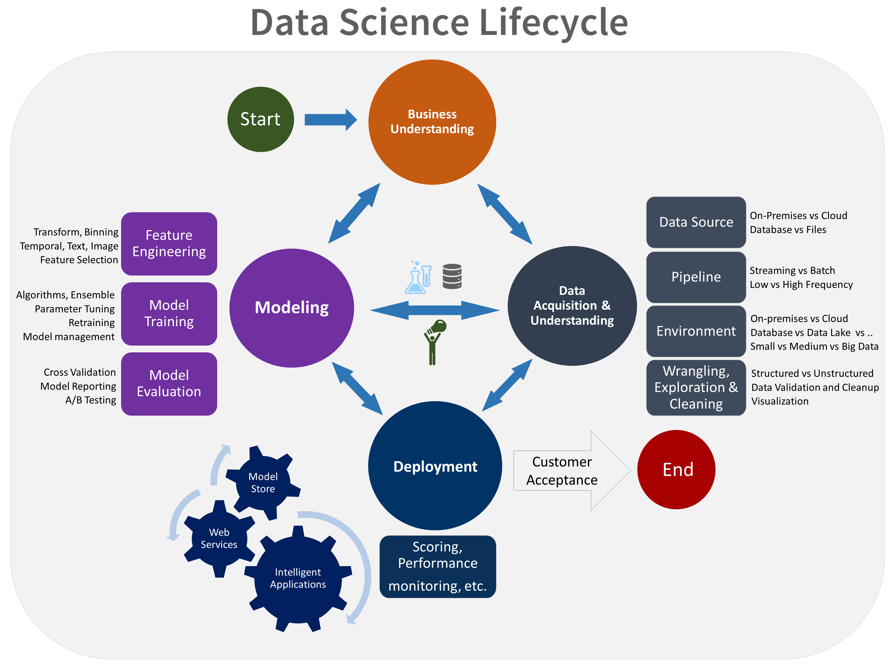
The Team Data Science Process
Notes:
If the discovery and architecture for the solution results in the need for a Prediction, Classification or Artificial Intelligence solution, you'll follow a Data Science process to understand the business requirements, examine the data from a customer database, create two experiments to find the best model, and deploy the completed model in a Stored Procedure that is called from a client application.
In this particular solution you'll set up your SQL Server environment and use a client tool to work with a database to create a predictive solution that you will deploy with a Stored Procedure.

Slide 41
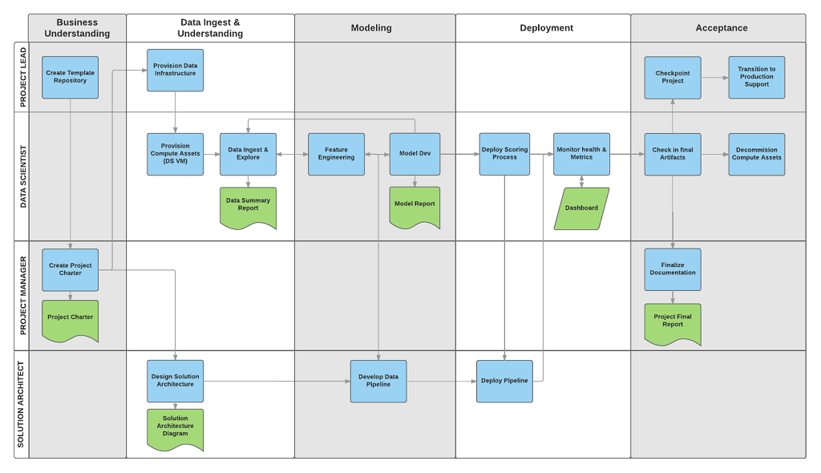
The Team Data Science Process
Notes:
SQL Server 2019 builds on the strength of previous releases. SQL Server has evolved from a departmental database in 2008R2 and before to a mission-critical, industry-leading database. In recent releases, we’ve added in-memory performance, innovative security features, end-to-end mobile intelligence, built-in AI, and support of OS, including Linux. With SQL Server 2019, we’ve invested heavily in big data…

Slide 42


Bringing intelligence to where data lives
Application + intelligence
Application
VS
Database
Intelligence + database
Regular database + app
Intelligence database + app
Notes:
What is in-DB ML? 2 sentences
- Bringing data science closer to the data platform
Audience polling - data scientist, data developer, application developer, DBA
There is something in it for everybody

Slide 43
Faster Time to Insights
Integration with SQL query execution
Parallel query pushing data to multiple external processes / threads
Use in-memory technology and Columnstore Indexes with ML scripts
Stream data in batches to the R/Python
Train and Predict using parallelism
RevoScaleR, revoscalepy, microsoftml for multi-threading and parallel processing
Native scoring for faster real-time predictions

